Slide 1
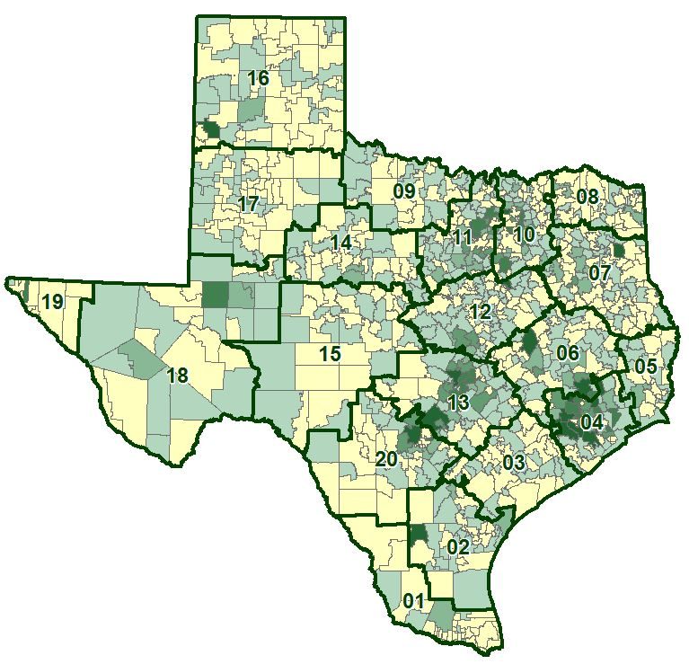
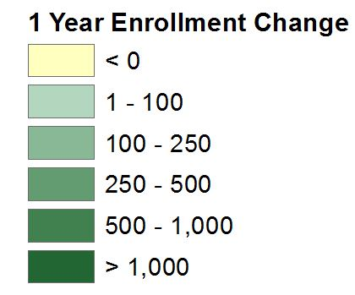
State Enrollment Trends – Pre COVID

Slide 2
5.55
State’s Fall 2020 set a record – First time in history enrollment decline
State’s Fall 2020 total enrollment would have likely been 5.55 million
Notes:
Source: Census

Slide 3
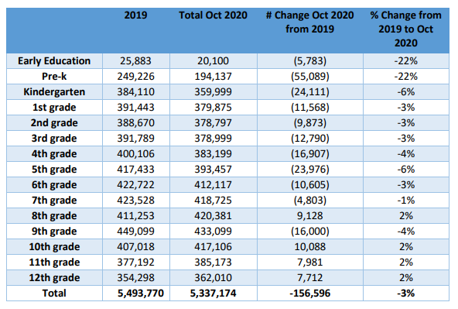
State Enrollment Trends
Notes:
Source: Census

Slide 4
Texas ISD Enrollment change
-211,766
The reality is that we are closer to (-211,766) decline when you factor in where we should have been.
Notes:
Source: Census

Slide 5
Texas ISD Enrollment change
State enrollment likely headed for record breaking growth year fall 2021
State’s enrollment growth likely to exceed 260,000 fall 2021
Notes:
Source: Census

Slide 6
Texas Total Enrollment
Fall 2021 will likely see the return of over 150,000 students plus the new growth
putting the state enrollment in position to see 5,600,000 students in public schools
Notes:
Source: Census

